Slide 1
El Modelo del Aprendizaje Familiar

Slide 2
Tabla de contenidos
01
EL modelo del aprendizaje familiar
INTERVENCIÓN CON FAMILIAS
02
03
CONCLUSIONES
El concepto y los objetivos del modelo.
Nuevos enfoques para trabajar eficazmente con las familias

Slide 3
01
MODELO DE APRENDIZAJE FAMILIAR
En esta unidad aprenderás:
Introducción al Modelo de Aprendizaje Familiar.
Los grupos destinatarios y los objetivos del Modelo.
Los recursos desarrollados.

Slide 4
ACTIVITY 1 – WHAT YOU WOULD DO
Break up a larger group into smaller groups of three or four people each.
Give each group a copy of the scenario.
The groups will discuss each situation and come up with a plan of action.
The participants will share their thoughts in a big group.

Slide 5
FAMILY LEARNING MODEL
The Family Learning Model provides age-appropriate learning materials for family members to help children (comic strips), teenagers (digital magazines), and senior adults (audiobooks) to support all members of their family to develop and maintain healthy relationships.

Slide 6
RESOURCES OF THE MODEL
COMIC STRIPS
AUDIOBOOKS
DIGITAL MAGAZINES
8 – 12 YEARS OLD
13 – 20 YEARS OLD
PARENTS & ADULTS

Slide 7
STRUCTURE OF THE FAMILY LEARNING MODEL
6 Strips of Mild Conflict Resolution
COMIC STRIPS
6 Strips of Positive Behaviours
12 COMIC STRIPS “Talking makes us stronger”
&
8 – 12 YEARS OLD
+ A short 3-page handbook

Slide 8
OBJECTIVES OF THE COMIC STRIPS
To support children to acquire skills to prevent and resolve daily conflicts and to be able to deal with situations of risk or violence. The resource is made up of 12 comic strips that illustrate six different families each must face a situation of conflict or risk; and another situation in which they practice positive and caring behaviors among the members of the family unit.

Slide 9
STRUCTURE OF THE FAMILY LEARNING MODEL
5 themes: (1) freedom to be myself;. (2) my communication is key; (3) mutual respect and boundaries;
(4) the importance of ‘me-time’; (5) solving conflicts
10 Digital interactive
Magazines
DIGITAL MAGAZINES
2 levels for each theme: Introductory level: age 13 to 17 yo Advanced level: age 18 to 20yo.
13 – 20 YEARS OLD

Slide 10
OBJECTIVES OF THE DIGITAL MAGAZINES
These magazines are to teach teenagers about how they can develop healthy relationships in their own lives.

Slide 11
STRUCTURE OF THE FAMILY LEARNING MODEL
6 themes: (1) Healthy and unhealthy family relationships (2) Self-care and awareness (3) Active againg and self-care (4) Self-confidence and self- esteem (5) Signs of elder abuse in its various forms (6) Available supports
10 Audio Books
AUDIOBOOKS
&
SENIOR ADULT
+ A short 3-page handbook

Slide 12
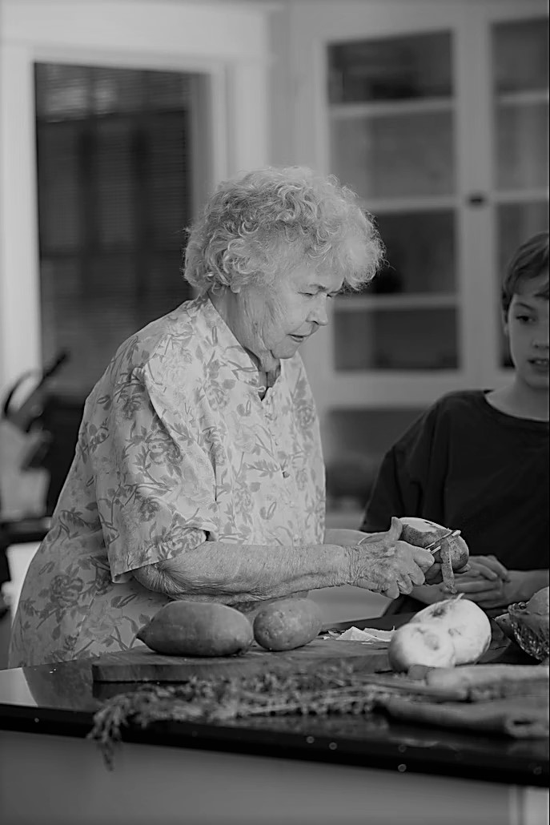
OBJECTIVES OF THE AUDIOBOOKS
To highlight some of the specific risks that senior adults are susceptible to, and also, to support them to prevent themselves from being victimised.

Slide 13
02
INTERVENTION WITH FAMILIES
In this unit, you will learn:
New approaches to effectively work with families.
Advice and guidance for supporting families.

Slide 14
ADVICE AND GUIDANCE FOR SUPPORTING FAMILIES
• Available to the children so they can consult them at any time independently.
• It is essential not to force children to participate or talk about themselves and to
do the activities when they are receptive.
• To practice the emotional vocabulary and the skills acquired, repeat the reading on different occasions and ask them how they feel so that they practice.
• Once communication is established, latent fears and conflicts may appear. If it
happens, you have to be receptive and willing to listen, even if you don't have the
tools to solve it.
COMIC STRIPS

Slide 15
ADVICE AND GUIDANCE FOR SUPPORTING FAMILIES
• Give time to children's interventions, without rushing, guaranteeing that they can finish properly and reviewing their experiences and key concepts. In this way, a safe environment is created where they can express their learnings and experiences.
• Recognise the contributions of children avoiding criticism and judgments. It is about reinforcing their self-esteem by guiding them to express their emotions and showing them alternative and appropriate solutions to different problems.
• It is advisable to participate in recognising emotions and own experiences to be a role model for the child and encourage him to express himself freely and sincerely.
• Asking often how they feel beyond reading these comics will encourage them to be aware of their emotional state, both in pleasant moments and in others that are not so pleasant.
COMIC STRIPS

Slide 16
ADVICE AND GUIDANCE FOR SUPPORTING FAMILIES
Encourage teenagers and young adults to explore the resources in their own time.
Guide them to explore the explainer videos, games and puzzles, and self-help resources.
Ask them reflective questions once they have completed the magazines. This can encourage them to speak about their experiences with the topics addressed in the resources.
Ensure that introductory-level magazines are aimed at teenagers between 13-17 years of age. Ensure that the advanced-level magazines are aimed at young adults aged 18-20.
Guide teenagers and young adults to talk about the topics and how they make them feel. This can help them to consider how they can develop healthy relationships in their own lives.
DIGITAL MAGAZINES

Slide 17
ADVICE AND GUIDANCE FOR SUPPORTING FAMILIES
Allow time for teenagers and young adults to explore the materials at their own pace. This can help them to better understand the thematic areas and develop their own perspectives.
Guide them with encouraging words to help them to feel comfortable sharing their thoughts and experiences.
Ask honest questions instead of leading questions. This can help to break down communication barriers that might inhibit them from sharing honestly.
Express empathy. This can create a “safe space” or comfortable zone whereby teenagers and young adults can feel open to learning and reflecting.
Practice active listening at all times.
DIGITAL MAGAZINES

Slide 18
ADVICE AND GUIDANCE FOR SUPPORTING FAMILIES
Assess the level of your elder's familiarity with technology. A few explanations on how to use them might be necessary.
Demonstrate how to use the audios with them.
Make sure they understand how to navigate through the website to reach the material.
Utilize the audios to initiate conversation and explore your elder's views on some of the topics.
Utilize the audio as a self reflective exercise for them to use at home.
AUDIOBOOKS

Slide 19
EFFECTIVELY WORK WITH FAMILIES
Keep it real
Teamwork is the key to
achieving desired outcomes
Respect their time
Ask questions
Share information,
brainstorm ideas and learn together
Open communication

Slide 20
ACTIVITY 2 – CASE STUDY
The family
• Bridget (25 years)
• John (30 years) left school without any qualifications and has been out
of work. He is currently serving a 2+ year sentence with further time on
license
• Jayden (junior school age) with Attention Deficit Hyperactivity Disorder
(ADHD)
• Erin (primary school age)
Social services have been involved with the family for about a year. The
children were briefly placed on the ‘at risk register’ as they were considered to
be at risk of physical abuse. John had involvement with social services when
he was a child himself.
John has a history of offending since his teens. There is a history of domestic
violence in the family.
The children were considered to be at risk of offending and anti-social
behaviour due to John’s repeat offending and family attitudes to offending.

Slide 21
ACTIVITY 2 – CASE STUDY
Intervention with the family
Identify strategies to work with this family and how to act using the resources of the Family Learning Model.

Slide 22
ACTIVITY 3 – ROLE PLAYS
The group will choose participants to carry out simulations in each scenario presented.
One participant will be the victim and another participant will be the professional.
At the end of each role-play, the facilitator will promote a discussion and reflection in the group, on the topics that emerged, the solutions, communication between victim and professional, and strategies proposed.

Slide 23
CONCLUSIONS
FAMILY LEARNING MODEL
All over Europe, families are in crisis. Families are the primary setting for domestic violence. With educational interventions targeted at a family level, and with effective referrals to social services available in each EU Member State, the goal of supporting families to take action to prevent and eradicate domestic violence within the family unit becomes achieved.
It is time for a proper family-centred educational approach that prevents families from reaching a crisis point.

Slide 24
“The European Commission’s support of this publication does not constitute an endorsement of the contents, which reflect the views only of the authors, and the Commission can not be held responsible for any use which may be made of the information therein.”
Project Number: KA220-ADU-07F8F183

