Slide 1
Theoretical knowledge about family violence and abuse in Europe

Slide 2
TABLE OF CONTENTS
01
CONCEPTS OF TYPE OF VIOLENCE IN EUROPEAN FAMILIES
02
KEY FACTORS
03
ROADMAP
04
CONCLUSIONS
The different forms of violence
in the family
The different forms of violence
in the family
Developing a mapping exercise
of services

Slide 3
TYPES OF VIOLENCE IN EUROPEAN FAMILIES
01
In this unit, you will learn:
What is violence and family violence.
Concepts of gender violence, child-to parents; parents-to-child, and elder abuse.
The different forms of violence
in the family.

Slide 4
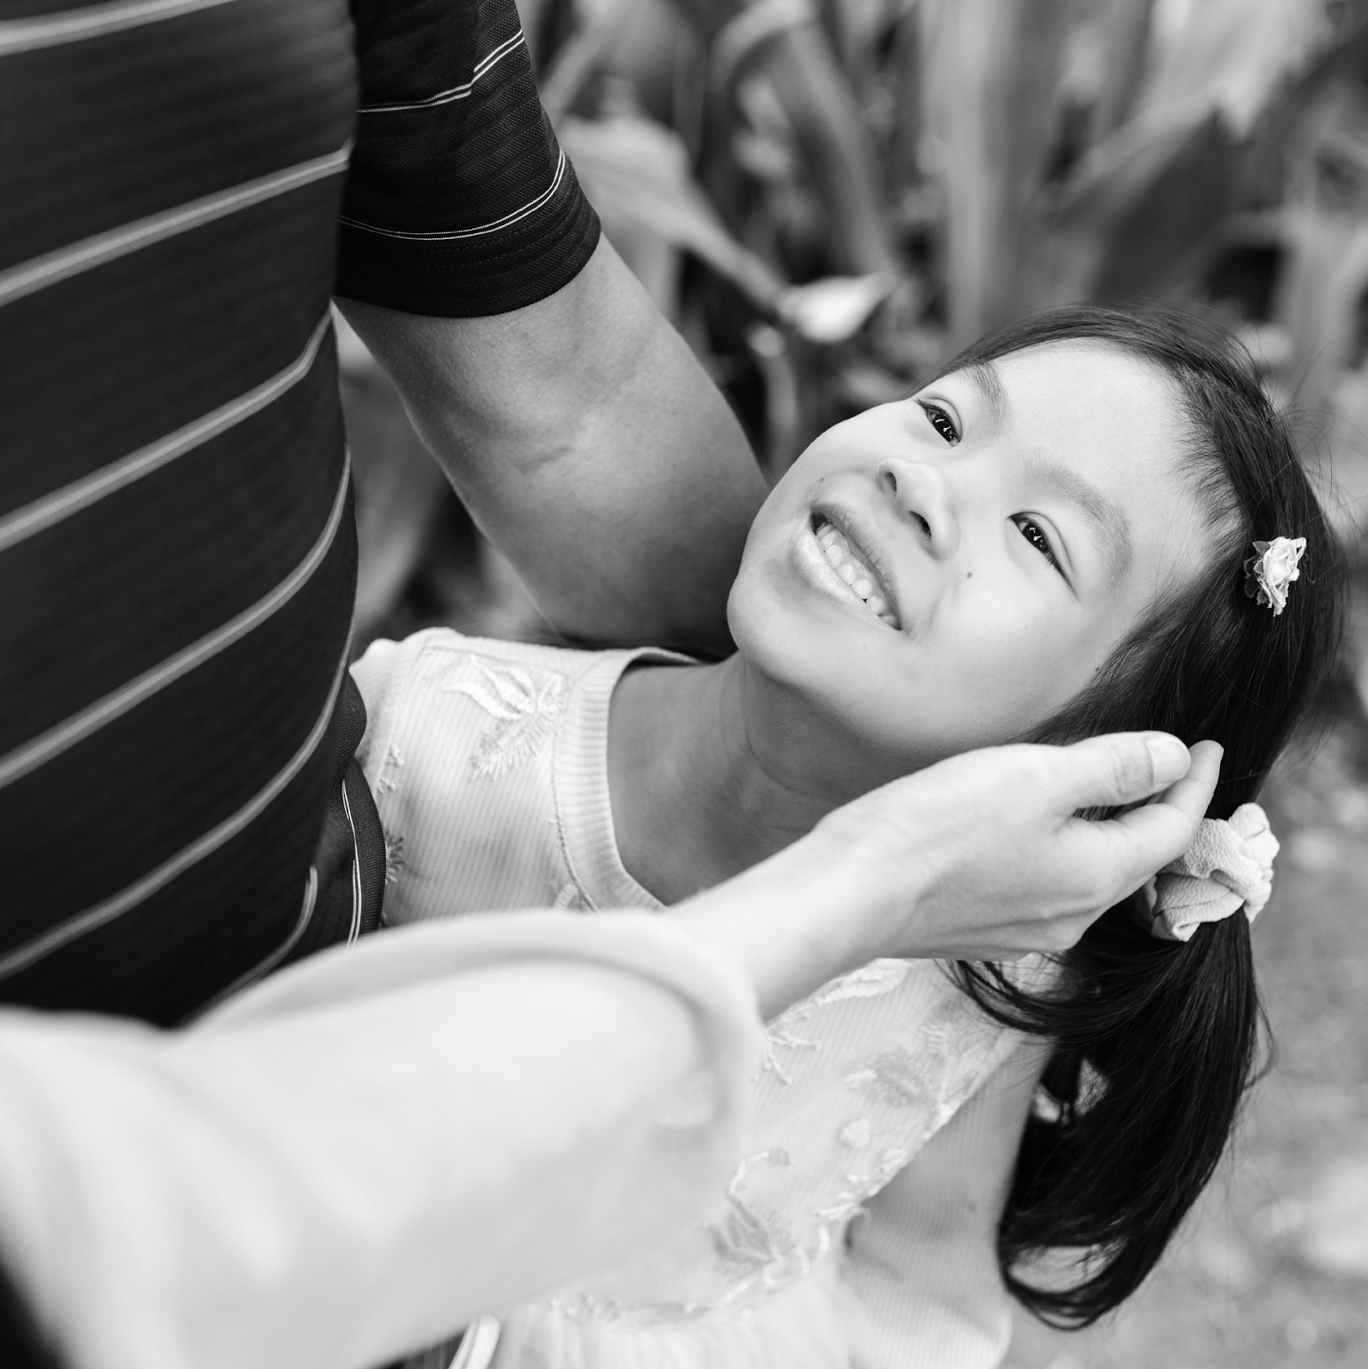
VIOLENCE
For the World Health Organization, violence involves the use of physical force not only against others, but against the person himself, and can have consequences such as trauma, psychological damage, or death.

Slide 5
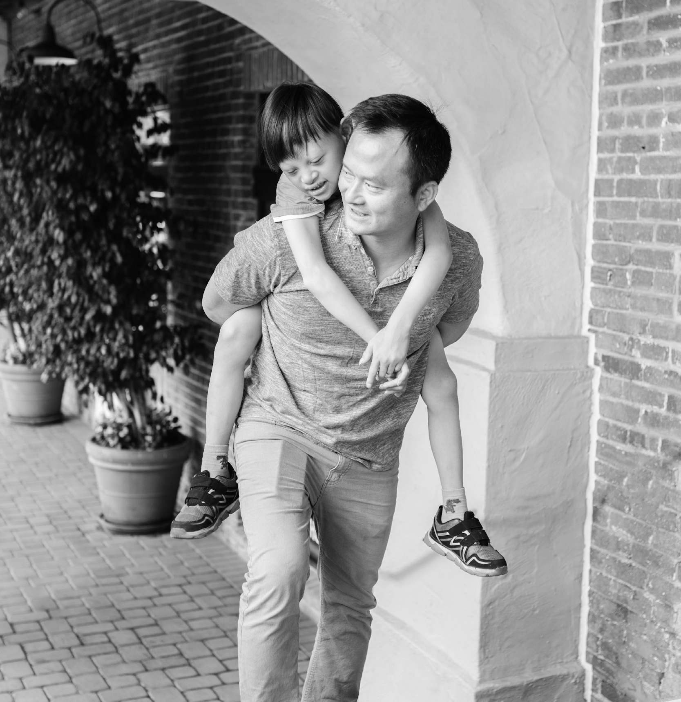
DOMESTIC VIOLENCE
“Domestic Violence” shall mean all acts of physical, sexual, psychological, or economic violence that occur within the family or domestic unit or between former or current spouses or partners, whether or not the perpetrator shares or has shared the same residence with the victim.
The Istanbul Convention

Slide 6
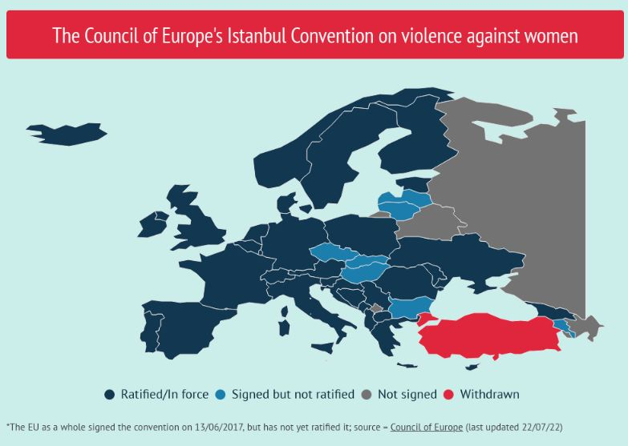
The purposes of this Convention are to:
Protect women against all forms of violence, and prevent, prosecute and eliminate violence against women and domestic violence;
Contribute to the elimination of all forms of discrimination against women and promote substantive equality between women and men, including by empowering women;
Design a comprehensive framework, policies, and measures for the protection of and assistance to all victims of violence against women and domestic violence;
Promote international cooperation with a view to eliminating violence against women and domestic violence;
Provide support and assistance to organisations and law enforcement agencies to effectively cooperate in order to adopt an integrated approach to eliminating violence against women and domestic violence.
CETS 210 - Council of Europe Convention on preventing and combating violence against women and domestic violence (coe.int)

Slide 7
WHAT IS FAMILY VIOLENCE?
Family violence is when a family member threatens, harms, controls or abuses another family member. Family violence can include violence by:
An adult in a family – for example, a partner or spouse, an adult child or an extended family member,
An adult who used to be in a family – for example, a former partner or spouse
A teenage child or young person in the family.
Family violence is sometimes also called domestic violence, intimate partner violence, or domestic abuse.

Slide 8
INTRODUCTION WHAT IS FAMILY VIOLENCE?
Family violence occurs within the family and is characterised by the intimacy and closeness present in the relationship between the aggressor and the victim, covering all the members who constitute the family or who were previously part of it. Its concept includes all types of abuses, temporary or permanent, which occur in the relationships within the family, and this (Alarcão, 2006; Resolution of the Council of Ministers, no. 88/2003). Ministers Resolution no. 88/2003).

Slide 9
FAMILY VIOLENCE AND …
CHILDREN
ELDERLY
CHILD-TO PARENTS
GENDER-BASED VIOLENCE

Slide 10
CONJUGAL/INTIMATE PARTNER VIOLENCE
Homosexual couples are also affected by the problem of couple violence.
Women are the most common victim.
The level of stress, increased by social prejudice and psychological violence, through fear of social exposure of their sexual orientation and the consequent loss of important relationships in their affective life, makes the victim more vulnerable to threats and drives them to remain in the relationship and the cycle of violence.
The UN defines violence against women as "any act of gender-based violence that results in, or is likely to result in, physical, sexual, or mental harm or suffering to women, including threats of such acts, coercion or arbitrary deprivation of liberty, whether occurring in public or in private life."
Intimate partner violence refers to behaviour by an intimate partner or ex-partner that causes physical, sexual or psychological harm, including physical aggression, sexual coercion, psychological abuse and controlling behaviours.

Slide 11
GENDER-BASED VIOLENCE
Gender-based violence and violence against women are terms that are often used interchangeably as it has been widely acknowledged that most gender-based violence is inflicted on women and girls by men.
Phenomenon is deeply rooted in gender inequality and continues to be one of the most notable human rights violations within all societies. Gender-based violence is violence directed against a person because of their sex. Both women and men experience gender-based violence but most victims are women and girls.

Slide 12
FAMILY VIOLENCE AND CHILD ABUSE
Non-accidental action or omission (of parents or surrogates) that prevents or endangers the child's safety and the fulfilment of his/her basic human and psychological/affective needs (Alarcão, 2006; Gabatz et al., 2013).

Slide 13
FAMILY VIOLENCE AND CHILD ABUSE
The aggressor is most often a parent.
The child may be a victim of family violence, directly or indirectly.
Increased risk in the future of presenting emotional and behavioural problems.

Slide 14
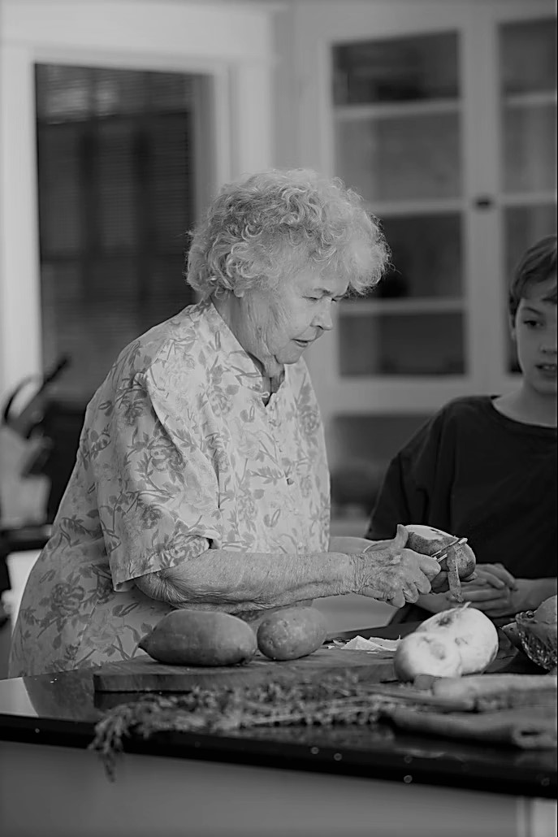
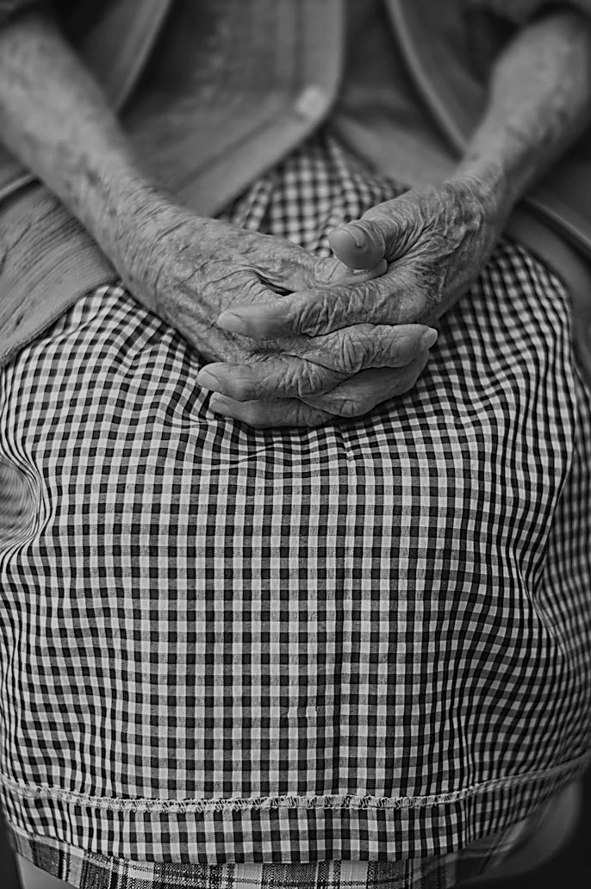
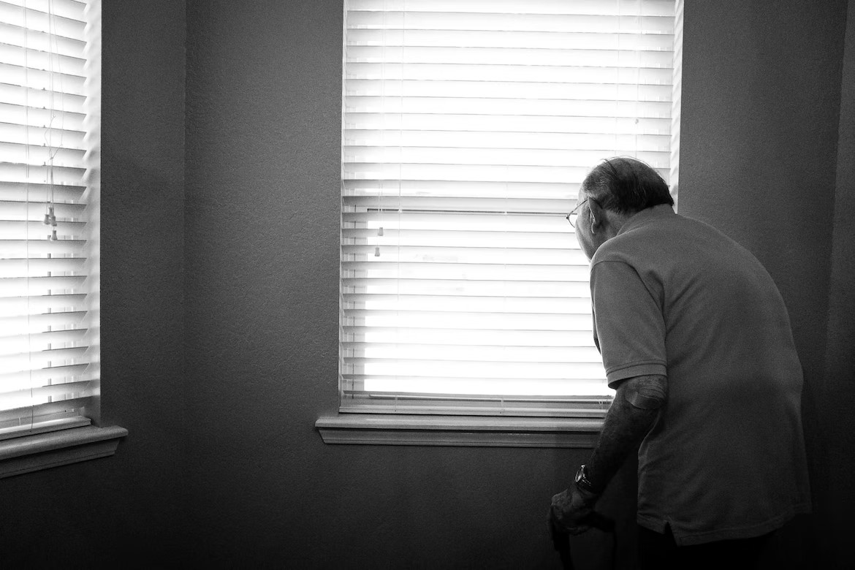
FAMILY VIOLENCE AND ELDER ABUSE
An act, continuous or isolated, within an intimate relationship and causing harm or discomfort to an elderly person, encompassing all the acts and omissions of any family member, which cause physical or psychological harm to the elderly person, such as physical aggression, disrespect, negligence in their care, lack of medical care, verbal, emotional and financial abuse, among others.
90% of cases of violence and neglect against older people usually take place in their own homes.
(WHO, 2002; Alarcão, 2006; Dias, 2009).

Slide 15
CHILD-TO PARENTS
Adolescent violence can be perpetrated against mothers, fathers, siblings and carers by daughters and sons. There are many reasons why it occurs. These include children witnessing or experiencing family violence or other forms of violence and repeating abuse patterns towards others, parenting styles, in times of conflict, traumatic or stressful situations, mental health or drug and alcohol issues, and other contributing factors. Sometimes there is no apparent reason why it happens.
Any behaviour used by a young person to control, dominate, or coerce their parents. It is often threatening and intimidating and can put family safety at risk.

Slide 16
TYPES OF VIOLENCE
NEGLECT AND ABANDONMENT
PHYSICAL
06
01
PSYCHOLOGICAL/ EMOTIONAL
05
VERBAL
02
04
03
SEXUAL
FINANCIAL/MATERIAL

Slide 17
ACTIVITY 1 – ECOMAP

Slide 18
KEY FACTORS
02
In this unit, you will learn:
Risk factors.
The health and social impacts
of family violence.

Slide 19
The risks factors – Child
Parents and Family
Living in a family where there is domestic violence
Mental health problems and drug and/or alcohol use
Lack of parenting skills
Characteristics: young, low income, low education, single parent,
many children
Socially disadvantaged or isolated
Parental history of abuse
Both men and women abuse children.
Social
High level of violence in the community
Neighborhood disadvantage
Abuse can also occur in stable, affluent households
with no apparent problems.

Slide 20
The risks factors – Elderly people
Cognitive impairment
Impaired physically
Suffering psychological distress
Suffering economic distress
Social isolation
Gender (region dependent)
Substance abuse by the caregiver
Shared living situation
Sociocultural factors (e.g. negative societal view on elder people,
urbanization, erosion of family bonds)
Aged greater than 80
Poor health
Depressive symptoms
Mobility difficulties
Gender being female

Slide 21
The risks factors – Gender-based violence
Lower levels of education
History of exposure to child maltreatment
(perpetration and experience)
Witnessing family violence (perpetration and experience)
Antisocial personality disorder (perpetration)
Harmful use of alcohol (perpetration and experience);
Community norms that privilege or ascribe higher status
to men and lower status to women;
Low levels of women’s access to paid employment
Low level of gender equality (discriminatory laws, etc.).

Slide 22
The risks factors – Child-to parents
Parenting styles or models of education
Absence of hierarchical structures
Change in roles
Clinical disorders and substance use
Personality characteristics and traits
Bi-Directionality of Family Violence

Slide 23
THE HEALTH AND SOCIAL IMPACT OF FAMILY VIOLENCE
Infants | Children | Teenagers | Adults | Elderly Adults
Injury Less control of emotions Problems with parent-child bonding Delays in growth and development | Anxiety Behavioural problems Failure at school Problems with friendships | Attempted suicide Obesity Anti-social behaviour (conduct disorder) Alcohol and drug use Other risky behaviours | Post-traumatic stress disorder Diseases and pain Trouble with relationships Lack of stable employment | Depression and loneliness Shorter life Dependence Financial problems
Adapted from: MacMillan, HL, Wathen, CN. (2014). Research Brief: Interventions to Prevent Child Maltreatment.
PreVAiL: Preventing Violence Across the Lifespan Research Network. London, ON. (PDF document)

Slide 24
ACTIVITY 2 – Case Scenario

Slide 25
03
ROADMAP
In this unit, you will learn:
Approaches to prevent and
respond to family violence.
Strategies to support and
effective intervention.
Develop a mapping exercise
of services.

Slide 26
FAMILY VIOLENCE INTERVENTION AND PREVENTION
Preventing Intimate Partner Violence
Strategy | Approach
Teach safe and healthy relationship skills | Social-emotional learning programs for youth Healthy relationship programs for couples
Engage influential adults and peers | Men and boys as allies in prevention Bystander empowerment and education Family-based programs
Disrupt the developmental pathways toward partner violence | Early childhood home visitation Preschool enrichment with family engagement Parenting skill and family relationship programs Treatment for at-risk children, youth and families
Create protective environments | Improve school climate and safety Improve organizational policies and workplace climate
Strengthen economic supports for families | Strengthen household financial security Strengthen work-family supports
Support survivors to increase safety and lessen harms | Victim-centered services Housing programs First responder and civil legal protections Patient-centered approaches
https://www.cdc.gov/violenceprevention/intimatepartnerviolence/prevention.html

Slide 27
FAMILY VIOLENCE INTERVENTION AND PREVENTION
Preventing Child Abuse and Neglect
Strategy | Approach
Strengthen economic supports to families | Strengthening household financial security Family-friendly work policies
Change social norms to support parents and positive parenting | Public engagement and education campaigns Legislative approaches to reduce corporal punishment
Provide quality care and education early in life | Preschool enrichment with family engagement Improved quality of child care through licensing and accreditation
Enhance parenting skills to promote healthy child development | Early childhood home visitation Parenting skill and family relationship approaches
Intervene to lessen harms and prevent future risk | Enhanced primary care Behavioral parent training programs Treatment to lessen harms of abuse and neglect exposure Treatment to prevent problem behavior and later involvement in violence
https://cdn.who.int/media/docs/default-source/documents/social-determinants-of-health/who_2022_plv_strategy_2022-2026_finalfile.pdf?sfvrsn=c819ff54_3&download=true

Slide 28
FAMILY VIOLENCE INTERVENTION AND PREVENTION
Preventing Youth Violence
Strategy | Approach
Promote family environments that support healthy development | Early childhood home visitation Parenting skill and family relationship programs
Provide quality education early in life | Preschool enrichment with family engagement
Strengthen youth’s skills | Universal school-based programs
Connect youth to caring adults and activities | Mentoring programs After-school programs
Create protective community environments | Modify the physical and social environment Reduce exposure to community-level risks Street outreach and community norm change
Intervene to lessen harms and prevent future risk | Treatment to lessen the harms of violence exposures Treatment to prevent problem behavior and further involvement in violence Hospital-community partnerships
https://www.cdc.gov/violenceprevention/youthviolence/prevention.html

Slide 29
INTERVENTION
PREVENTION
EARLY INTERVENTION
RESPONSE
OR
Primary
prevention
OR
Secondary prevention
OR
Tertiary
prevention

Slide 30
What can this work look like?
PREVENTION
Implementing whole school initiatives that promote gender equality and respectful relationships.
Developing awareness-raising campaigns that make it clear sexism and disrespecting women is never acceptable.
Supporting a local sports club to develop policies and procedures that ensure women and children have equal access to resources and appropriate facilities to support their participation in sport.
Implementing workplace initiatives that take a whole of organisation approach to addressing the drivers of family and gendered violence. This may include addressing unequal workplace policies, processes, leadership, and workplace culture.
OR
Primary
prevention

Slide 31
What can this work look like?
EARLY INTERVENTION
Developing resources to support people to understand family violence and recognise if they are experiencing it.
Providing information and training about family violence, legal rights and support services to people who are at higher risk of experiencing violence or professionals who work with them.
Working with boys who have shown early signs of or begun using violence to stop them from continuing to use violence as adults.
Delivering education sessions at a sports club about sexual assault and the legal consequences after women have reported experiencing sexual harassment.
OR
Secondary prevention

Slide 32
What can this work look like?
RESPONSE
Talking to victim survivors about their experience of violence and assessing their level of risk.
Working with the victim survivor if they choose to stay in their relationship, to help them to remain safe.
Providing case management support including arranging crisis accommodation, supporting victim survivors to secure housing, advocating for victim survivors navigating the legal system, and providing referrals and support.
Police protection and response (for example, responding to incidents of family violence).
OR
Tertiary
prevention

Slide 33
INQUIRE ABOUT NEEDS AND CONCERNS
Don’t
Criticise the offender. Focus on behaviour, not personality.
Blame the victim. This is what the abuser usually does.
Underestimate the potential danger to the victim and yourself.
Promise any help you can't get.
Give conditional support.
Do anything that might provoke the abuser pressures the victim.
Give up. If she/he is not willing to open up at first, be patient.
Do anything to make life difficult for the victim
Talk about their own experiences of violence or exploitation.
Give statements that are based on anything other than facts.
Justify the acts of violence.
DO
Be patient and calm.
Let them know you are listening; for example, nod your head or say, “hmm….”.
Acknowledge how they are feeling.
Let them tell their story at their own pace.
Give them the opportunity to say what they want. Ask, “How can we help you?”.
Encourage them to keep talking if they wish. Ask, “Would you like to tell me more?”.
Allow for silence. Give them time to think.
Stay focused on their experience and on offering them support.
Acknowledge what they want and respect their wishes.

Slide 34
SERVICE MAPPING
Visual representation of services.
Map a service.
STEPS:
Work out what you want the map to do.
Get an idea of what you’d like the map to look like.
Gather the resources you’ll need to create a first draft of the map.

Slide 35
KEY QUESTIONS TO ADRESS IN A SERVICE MAPPING EXERCISE:
Where are services currently located?
Who are services available to (e.g. age/sex, specific forms of violence against women, elderly people, or children)?
Who is using them?
When are services available (opening times)?
What do the services provide (ideally including standards and quality control)?
What protocols are in place?
Who delivers these services?
Which services do they refer to and receive referrals from?
What are the outcomes for service users?
What does it cost to provide the services and what levels of investment do they receive?
Adapted from Response to Sexual Violence Needs Assessment Toolkit (Department of Health, England, 2011), London: Department of Health.

Slide 36
ACTIVITY 3 – CONDUCT A SERVICE MAPPING EXERCISE
Mapping support services in the field of family violence.
Education and training providers.
Government departments.
Specialist family violence services.
Organisations working specifically on violence.
Health services and counseling services.
Community groups.
Identify at a local level, professionals and services working in the area of family violence.
It is important know what forms of violence the services cover and whether they are geographically concentrated in specific areas.

Slide 37
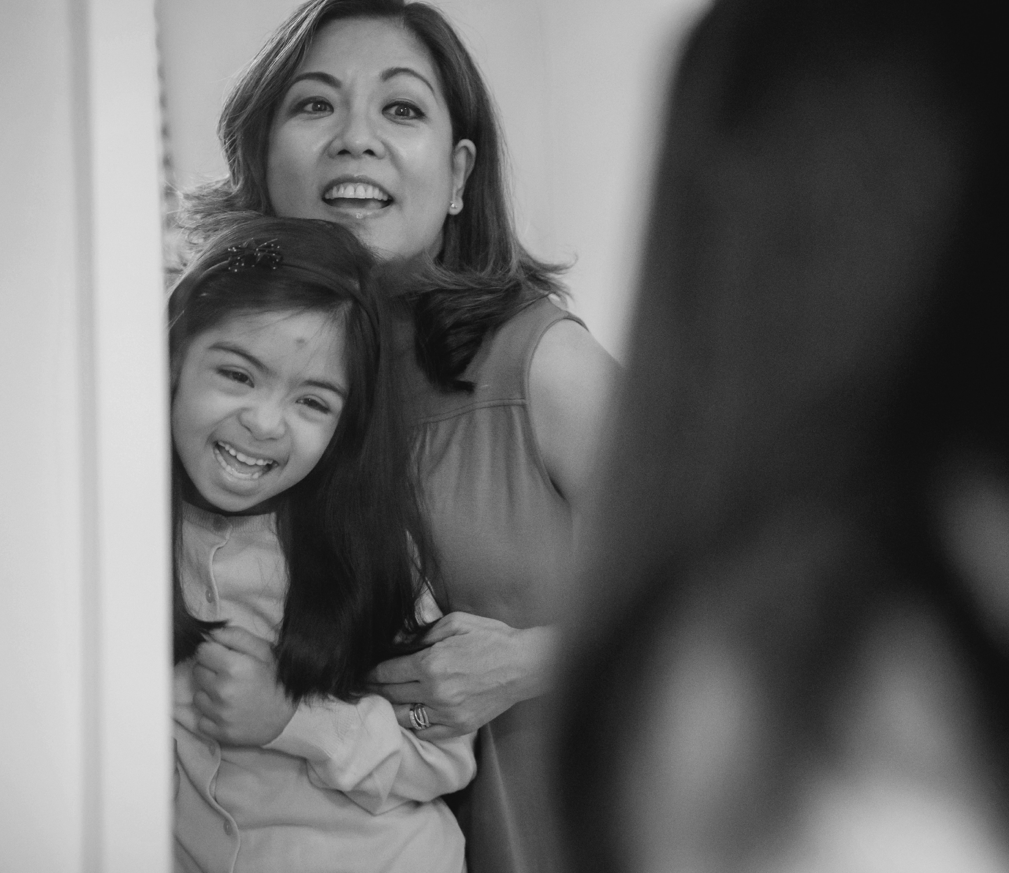
CONCLUSIONS
Violence is an urgent public health problem. From infants to the elderly, it affects people in all stages of life and can lead to a lifetime of physical, emotional, and economic problems.
Preventing and responding to family violence can help to reduce its negative, long-term effects on health, and social and economic well-being. It is possible to prevent family violence from happening in the first place by promoting and supporting it.

Slide 38
“The European Commission’s support of this publication does not constitute an endorsement of the contents, which reflect the views only of the authors, and the Commission can not be held responsible for any use which may be made of the information therein.”
Project Number: KA220-ADU-07F8F183

