Slide 1
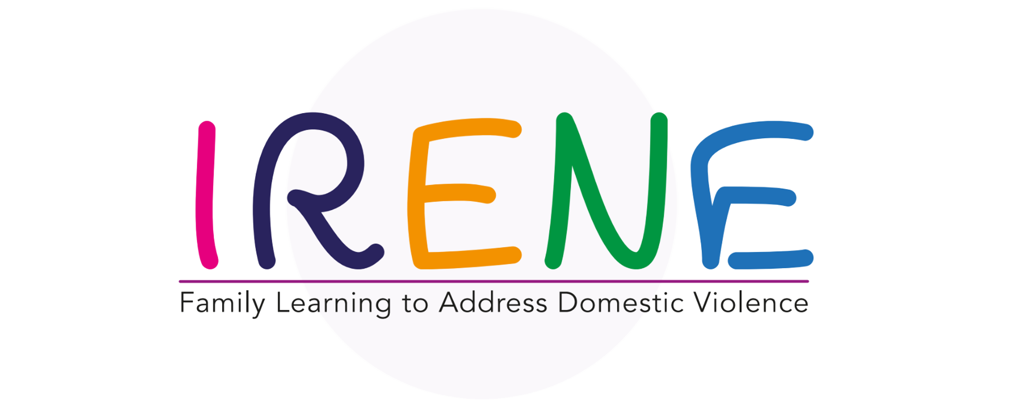
I’m capable to create my own Comic Strips and Audio Books

Slide 2
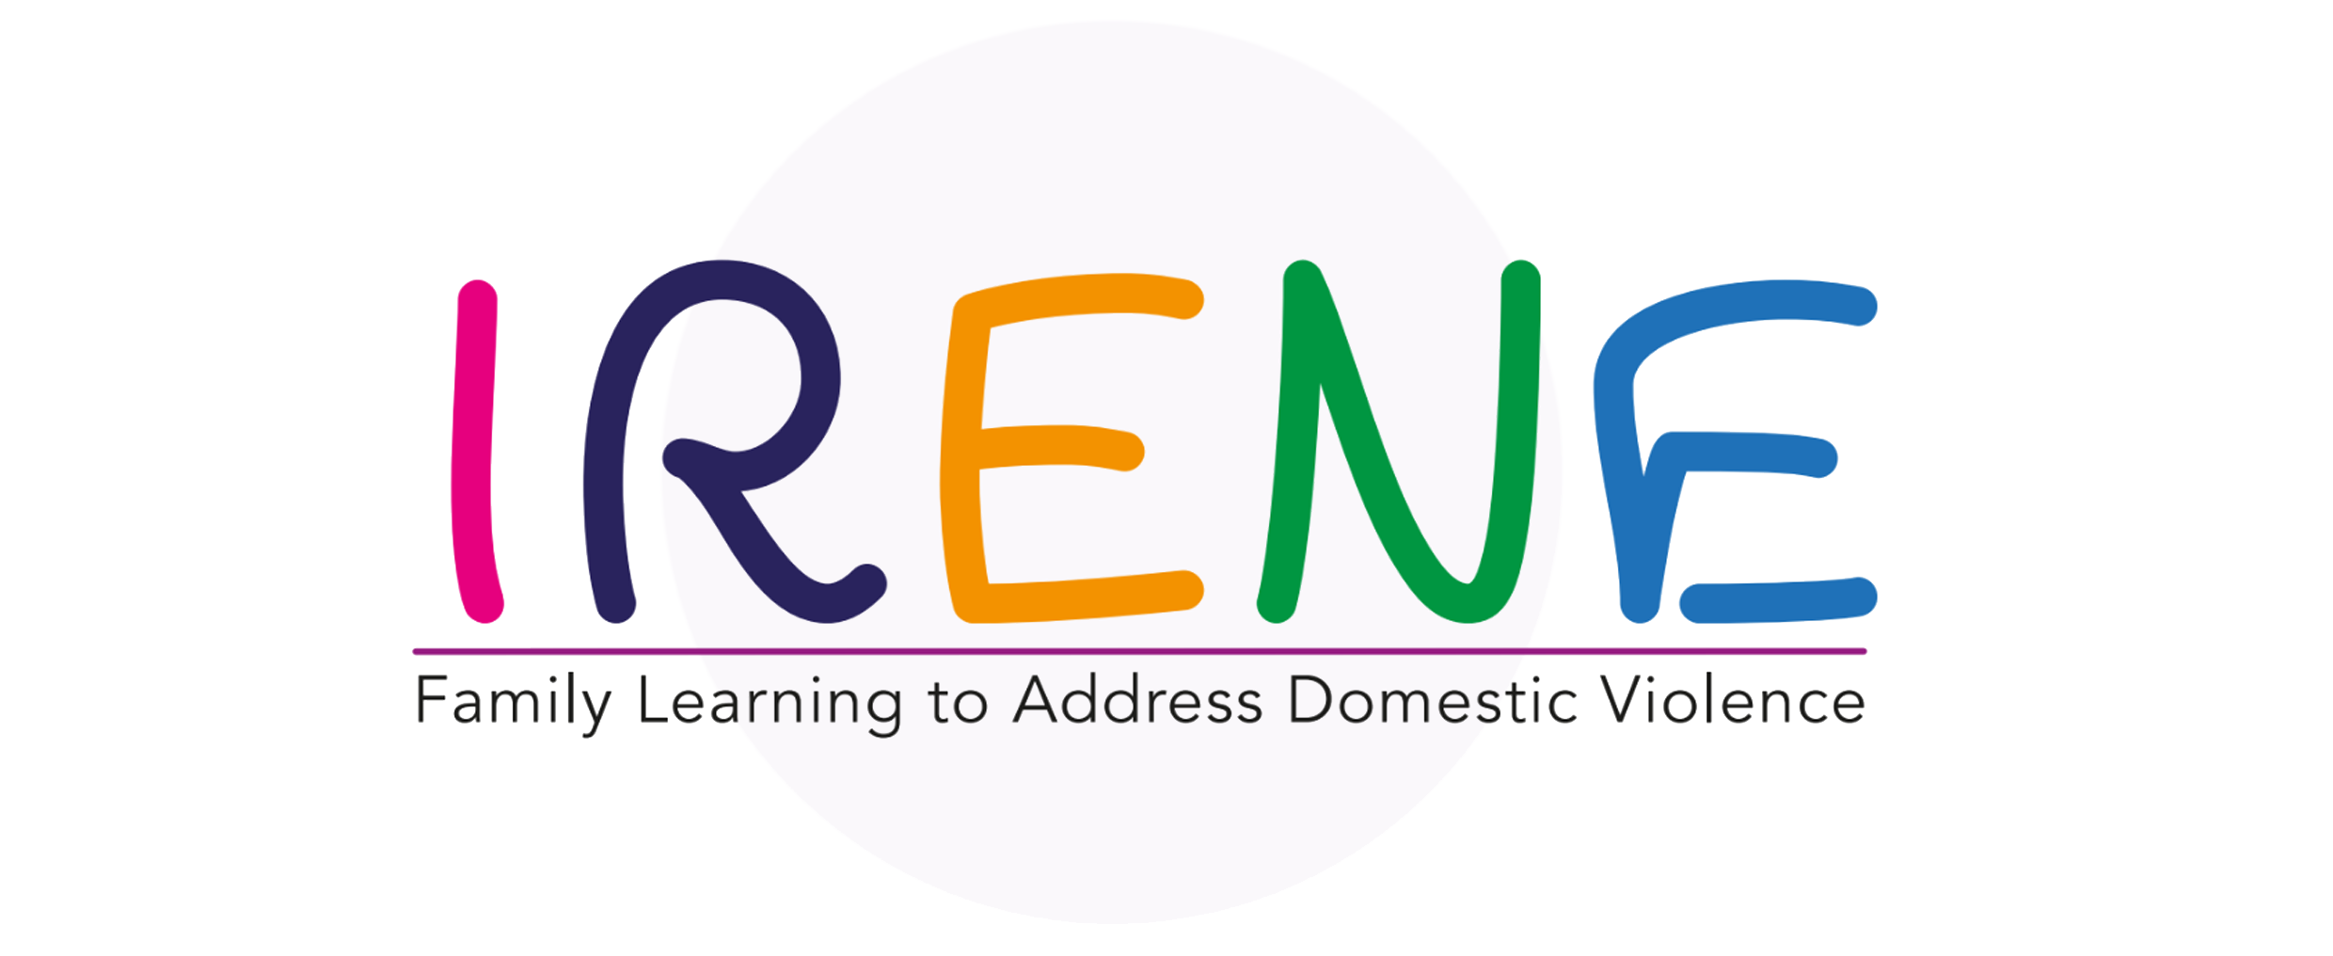
TABLE OF CONTENTS
01
COMIC STRIPS AND AUDIO BOOKS
BEST PRACTICES
02
03
CONCLUSIONS
Introduction of the concepts and benefits of intervention
How to develop and produce Comic Strips and Audio Books

Slide 3
COMIC STRIPS AND AUDIO BOOKS
01
In this unit, you will learn:
What are comic strips and audio books
The benefits of using these resources during the intervention.

Slide 4
COMIC STRIPS
A comic strip is a series of drawings that tell a story, especially in a newspaper, book or magazine.

Slide 5
WHAT IS A COMIC STRIP AND HOW TO CREATE ONE

Slide 6
ACTIVITY 1 – BRAINSTORMING
Why can comics strips be beneficial in intervention with families?

Slide 7
BENEFITS
COMIC STRIPS
Creating comic strip conversations has been extremely helpful in:
facilitating conversation,
resolving social issues between peers
taking turns in conversation
Provide different social scenarios within various contexts.
helps the child to look at the problem from his/her own perspective and makes the child more sensitive to the feelings and motives of the behaviour of others.

Slide 8
ACTIVITY 2- DESIGN YOUR CHARACTER
Look at different comic strip heroes. Get suggestions from the class of names: Superman, Bart Simpson, Asterix, Tin Tin or others. Encourage the learners to tell you about their favourite comic book characters. Ask them to describe one character in pairs.
What makes this character special?
What can they do? Have they got special powers?
What are their weaknesses?
What do they look like?
What are their special interests or ambitions?

Slide 9
Audiobooks are voice recordings of the text of a book that you listen to rather than read. Audiobooks can be exact word-for-word versions of books or abridged versions. You can listen to audiobooks on any smartphone, tablet, computer, home speaker system, or in-car entertainment system.
An audiobook allows a person to listen to a recording of the text of the book, rather than read the text of the book.
AUDIOBOOKS

Slide 10
Some of the most common websites and apps people use to find and purchase audiobooks include:
Apple Books
Audible.com
Nook Audiobooks
Google Play Books
Kobo
“When you read a book, the story definitely happens inside your head. When you listen, it seems to happen in a little cloud all around it, like a fuzzy knit cap pulled down over your eyes.”
Robin Sloan

Slide 11
WHAT IS A AUDIOBOOK AND HOW TO CREATE ONE

Slide 12
WHAT IS A AUDIOBOOK AND HOW TO CREATE ONE

Slide 13
ACTIVITY 3 – IN THE COURT OF AUDIO BOOKS
Divide the group into 2 small groups.
One group is in favour of using audio books with families and the other group will be against the use of audio books.
Each group should argue why they are for and against and try to get the opposing group to change their opinions based on their arguments.

Slide 14
BENEFITS
Improves time management
Builds literary skills: Younger readers who regularly listen to audiobooks have shown an increase in reading accuracy by up to 52%, improved comprehension by up to 76%, and an increase in reading speed, pronunciation, and expanded vocabulary.
Makes learning easier: Listening is the first language skill humans acquire, so it comes as no surprise that 85% of what we learn, we learn by listening. Additionally, when print and audio are combined, it increases our ability to recall information by 40%.7
Inclusive of those with disabilities: Providing the option to listen to a story opens your book up to those with disabilities, such as learning disabilities, vision impairment, and dyslexia, who find the task of reading extremely difficult or impossible.
Can ease anxiety and depression: Engaging with a story through an audiobook is a potential way to disrupt the negative thinking patterns associated with anxiety or depression.
AUDIO BOOKS

Slide 15
02
BEST PRACTICES
In this unit, you will learn:
How to develop and produce Comic Strips and Audio Books

Slide 16
TIPS FOR COMIC STRIPS

Slide 17
MAKE COMIC STRIPS ON CANVA
1- Open Canva: Launch Canva and search for "Comic Strip" to start making your own comic strip.
2- Search through templates: Start with a blank page or choose from one of Canvas ready-made templates. Browse comic strip templates for every theme, style and layout. Once you find the perfect template, just click on it to start designing.
3- Experiment with features: Designing your comic strip is easy because each template comes with a complete page, a blank page, speech bubbles and two pages of illustration sets. Easily drag and drop elements to your design.
4- Customize your comic: Get creative with your own colour scheme, layout, font style and combination of stickers, icons and illustrations. Rearrange speech bubbles and frames, or upload your own images and art.
5- Publish and share: Once you’re happy with your comic strip design, you can post it on Facebook or Instagram. Or download and make high-quality prints at home. You can design with friends using the collaboration tool, too.
https://www.canva.com/create/comic-strips/

Slide 18
YOU CAN DO IT! STEPS
Writing a Script: Decide on a story that you want to publish.
Decide what you want your story to be about. With strips, you really don't have to know every little detail of the story you are trying to tell, but you should have a basic idea of where it's going. This can help you make sure that you've got material for more than just the first few strips. Focus on the plot of the story, think about the concept, and then think about how that plot is going to work.
Decide on your format. You'll first need to decide how many panels you want to average, if you want one row or two, etc. Sticking to a particular size will matter most if you plan on publishing your comics in print (such as in a newspaper). If you plan on having them online instead, don't worry about this as much.
If you're printing and even if you're not, it's best to at least keep the same width and height for a single row. You can have one strip with one row, and another strip with two rows, but all three rows should be the same width and height as each other.

Slide 19
YOU CAN DO IT! STEPS
Plan each panel. When you go to make an individual strip, write down and plan each panel. You need to know what is happening where, which characters will be included. Keep it simple. A written script should be as bare-bones as possible. Descriptions of scenery should only be included if they are necessary to the action of the strip.
Balance text and images. Make sure that you aren't putting too much text in your panels. This can make the comic hard to read and enjoy. Try to limit the number of speech balloons to 2 (3 if there's a one or two-word balloon), and keep the number of words in a panel below 30 and preferably below 20.

Slide 20
MAKE COMIC STRIPS ON CANVA

Slide 21
ACTIVITY 4 – Make your Comic in Canva

Slide 22
TIPS FOR AUDIO BOOKS
Be consistent in the overall sound
Formatting consistency in audio levels
Tone noise level spacing
Pronunciation gives the listener an enjoyable experience
space to record without noise

Slide 23
TIPS FOR AUDIO BOOKS

Slide 24
CONCLUSIONS
COMIC STRIPS
AUDIO BOOKS
Are forms of storytelling that offer unique and engaging experiences for families. Creating them involves careful planning and execution, but with the right tools and techniques, anyone can bring their imagination to life and share it with others. Whether it's through the use of vivid illustrations and dialogue in comic strips, or through voice acting and sound effects in audio books, the goal is to captivate audiences and bring stories to life. Both comic strips and audio books provide a fun and creative way to educate, entertain, and inspire families.

Slide 25
“The European Commission’s support of this publication does not constitute an endorsement of the contents, which reflect the views only of the authors, and the Commission can not be held responsible for any use which may be made of the information therein.”
Project Number: KA220-ADU-07F8F183

